Slide 1
Iowa Liquor Sales
Project 3

Slide 2
Overview
Objective
Data Set
Model/Projections
Projected Sales 2016
Top Sales
Top Growth
Top Sales & Growth
Best Location

Slide 3
Objective
Investigate the market data to pinpoint the best location for a potential new storefront
Best location is considered to have both high growth and sales

Slide 4
Data Set
Iowa Liquor sales
10% of sample data
# of records: 269,810
https://data.iowa.gov/Economy/Iowa-Liquor-Sales/m3tr-qhgy/data

Slide 5
Model/Projections
Projections used Linear Regression Model
Variables Used for Prediction
Model Creation
Prediction
Q1 2015 Volume Sold (Liters)
Q1 2015 Sales
2015 Sales
Q1 2016 Volume Sold (Liters)
Q1 2016 Sales
2016 sales

Slide 6
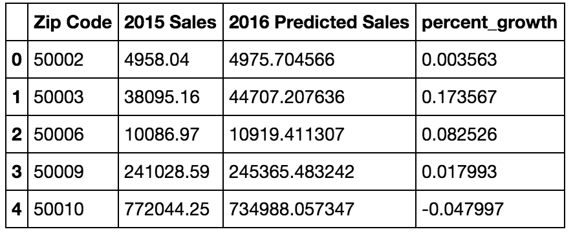
Data Table
Predicted Projections per Zip Code

Slide 7
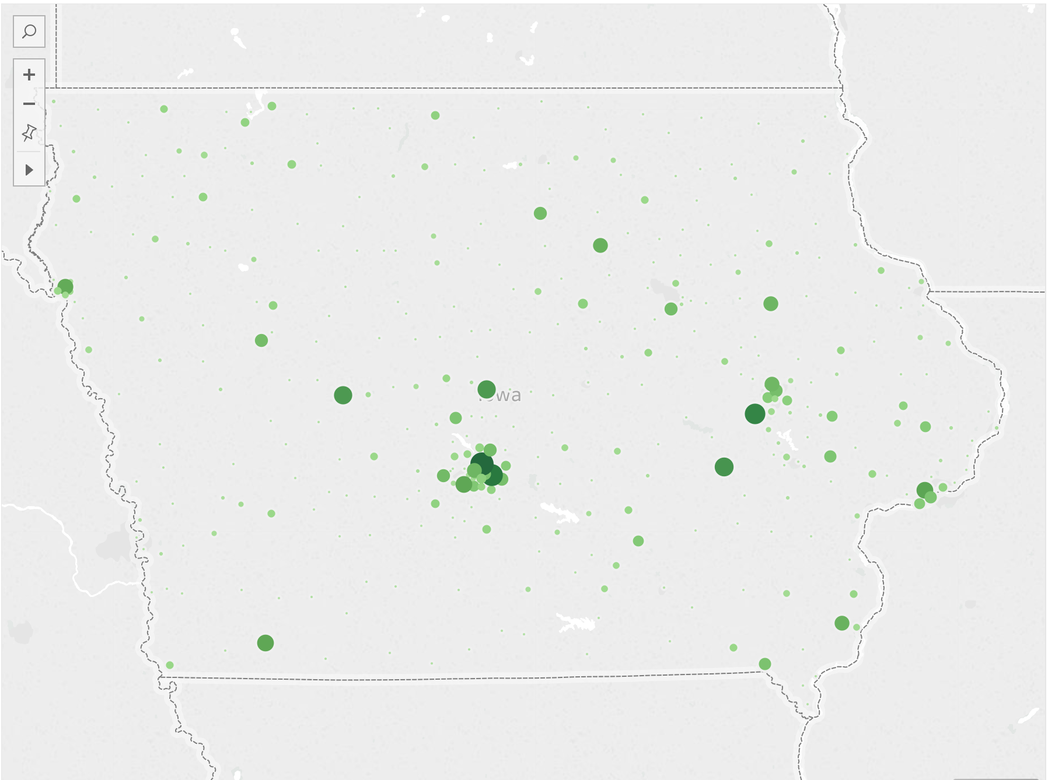
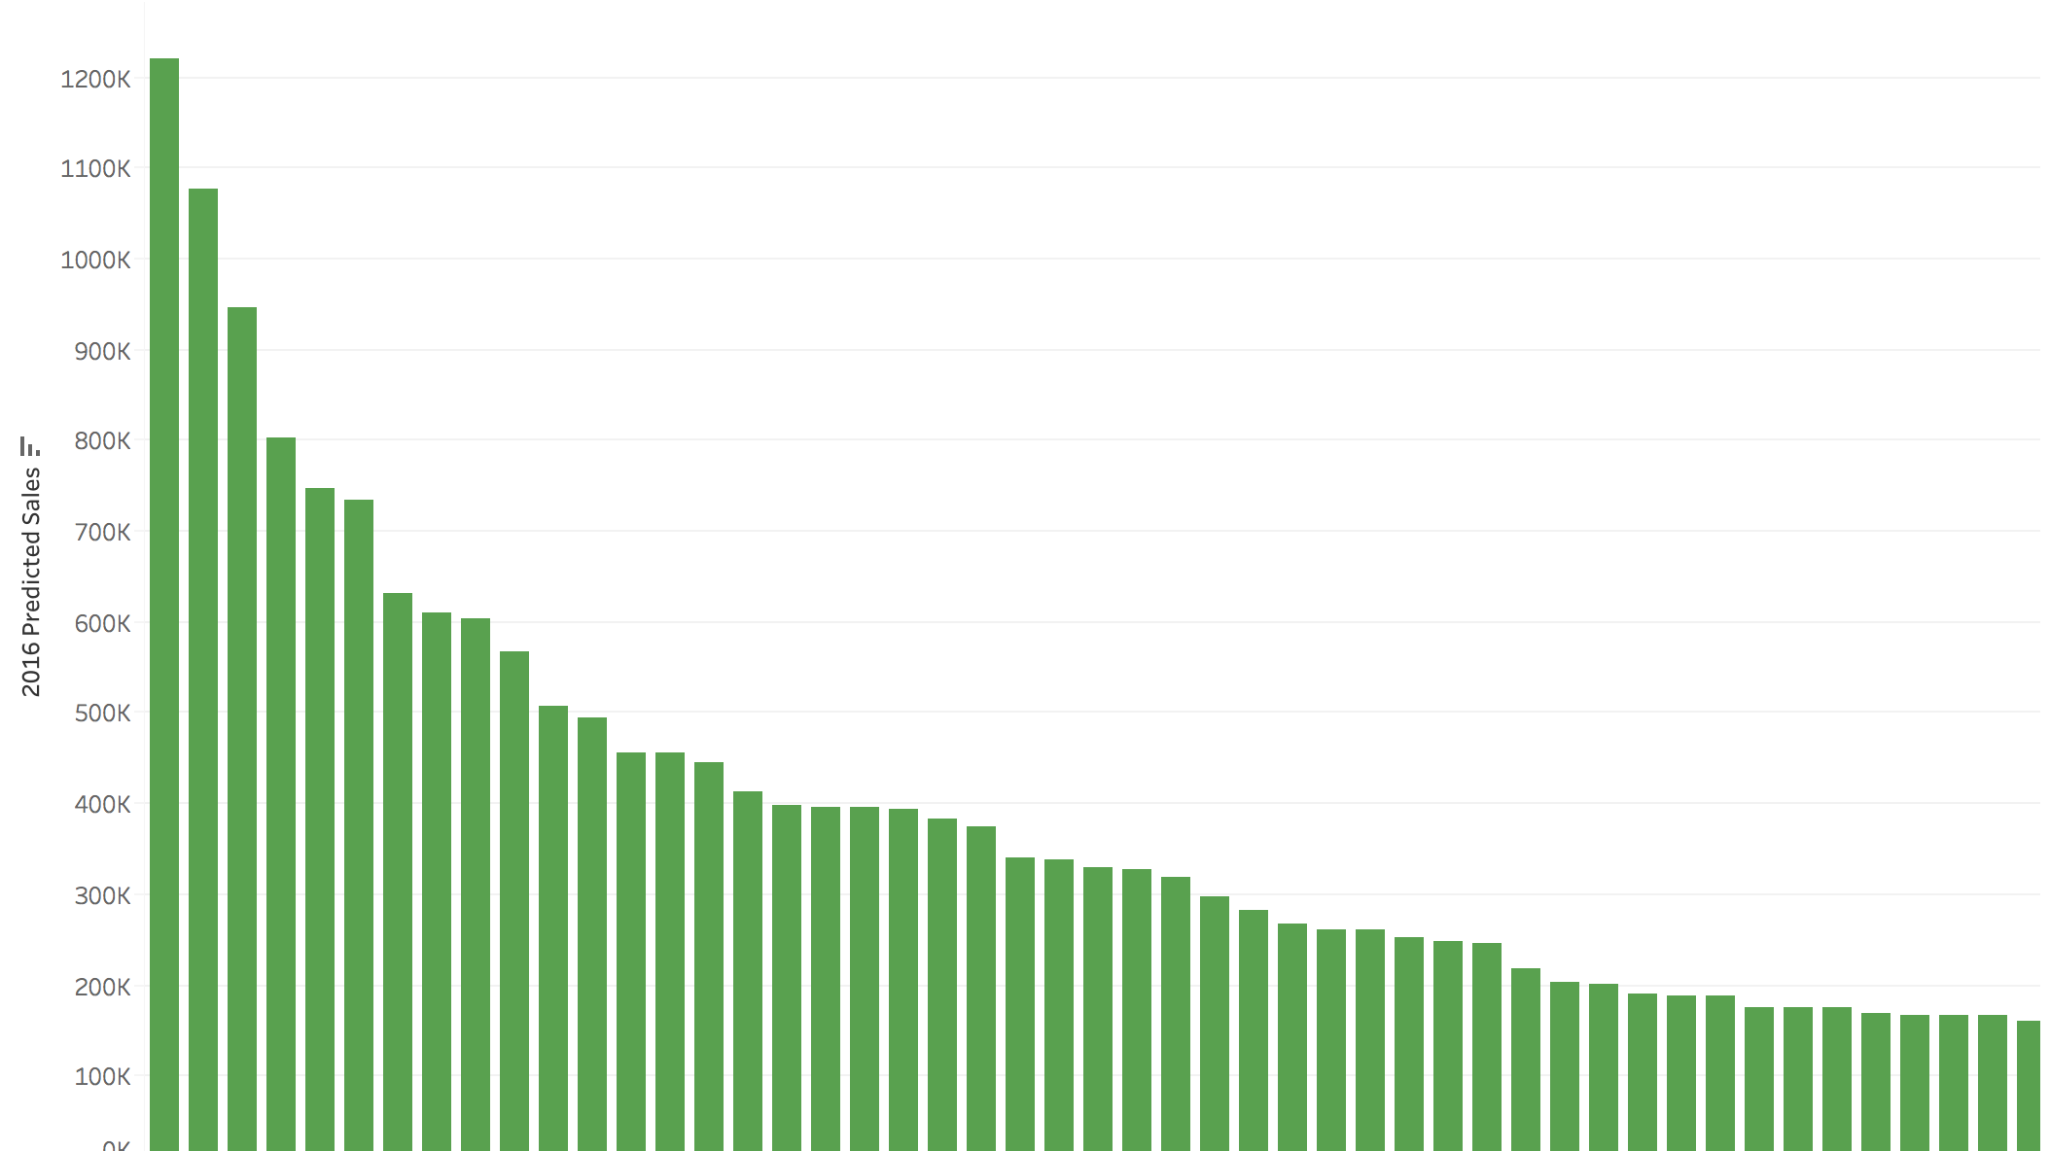
Top Sales

Slide 8
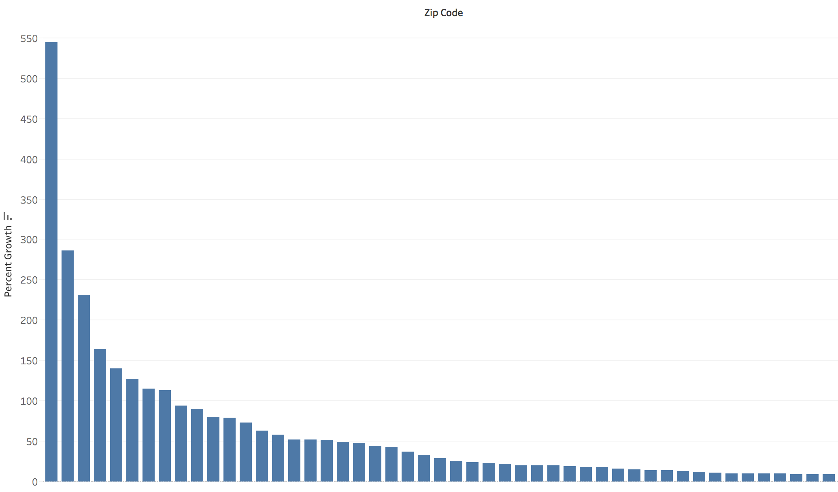
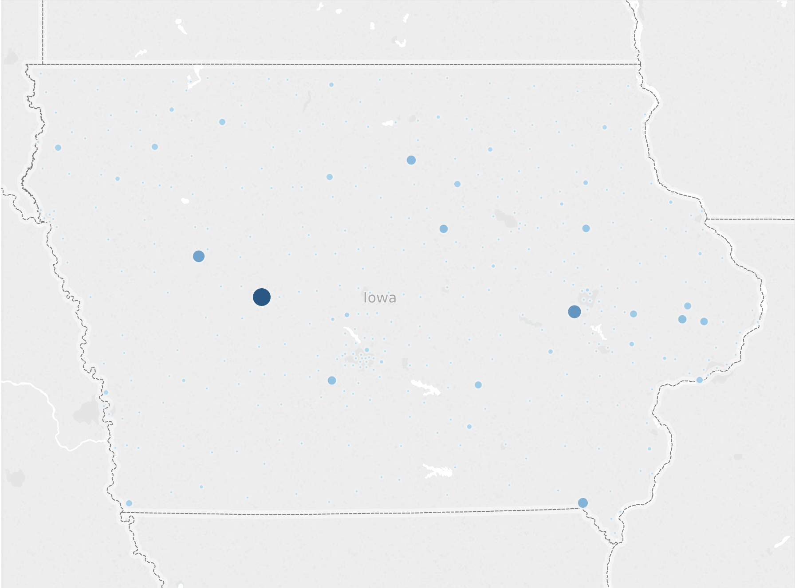
Top Growth

Slide 9
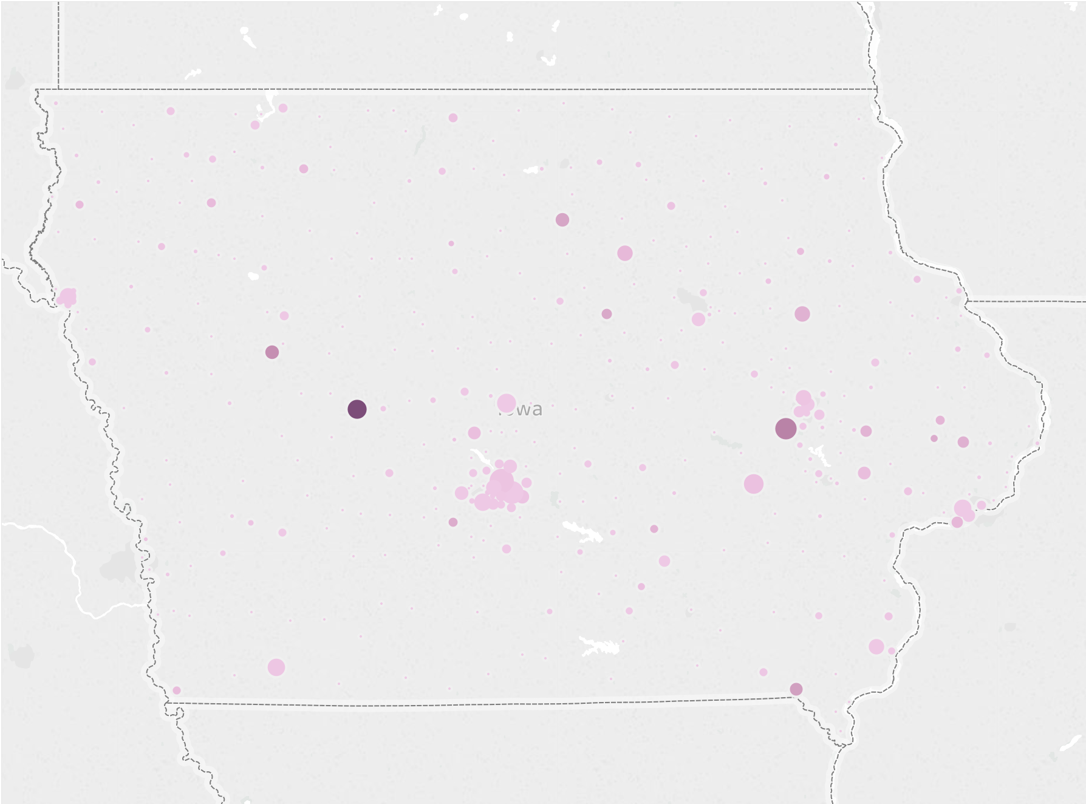
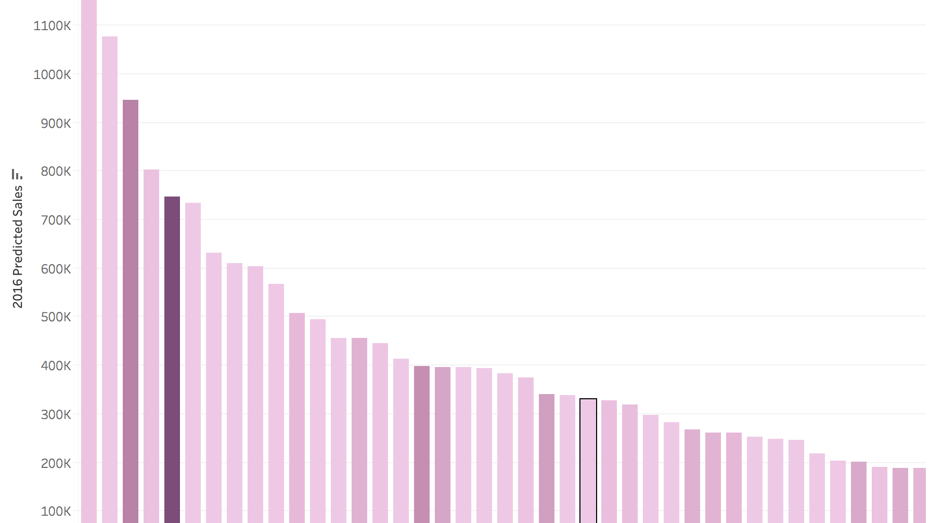
Top Sales(Size) & Top Growth(Color)

Slide 10
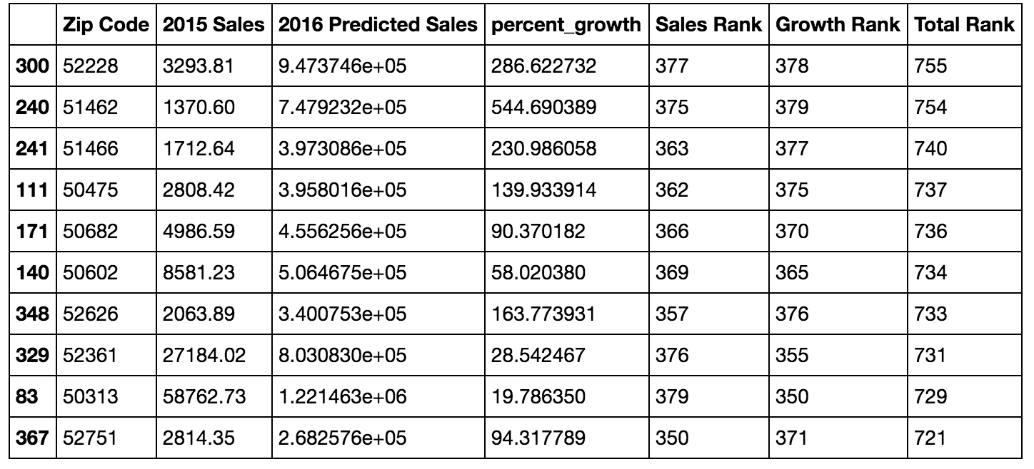
Rankings for Best Location

Slide 11
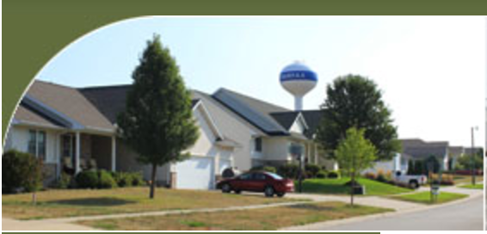
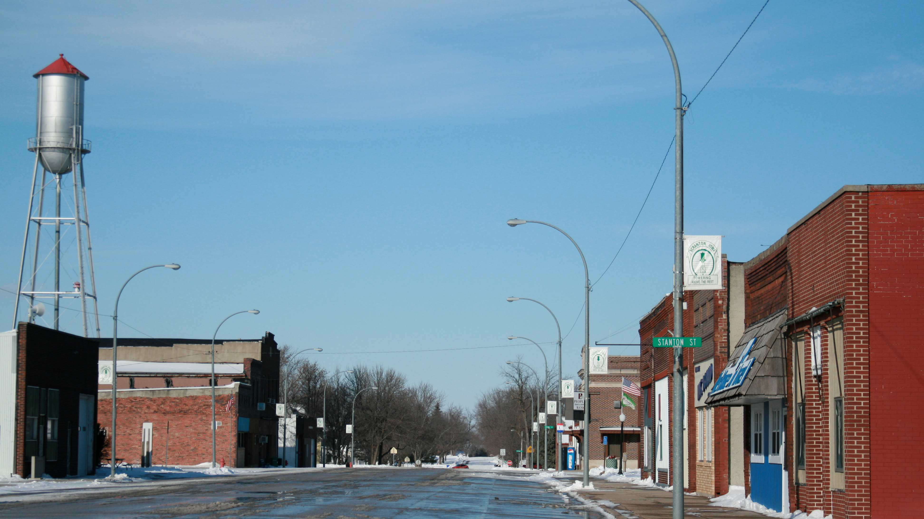
Best Location?
Fairfax, Iowa
Scranton, Iowa

